Slide 1

CAMPUS PEER-TO-PEER E-COMMERCE
ShopSphere
Connecting students to buy and sell safely on campus. Meet up locally and pay on delivery.
Primary Target
Key Payment Method
Hostels & Student Halls
Pay on Delivery / WhatsApp

Slide 2

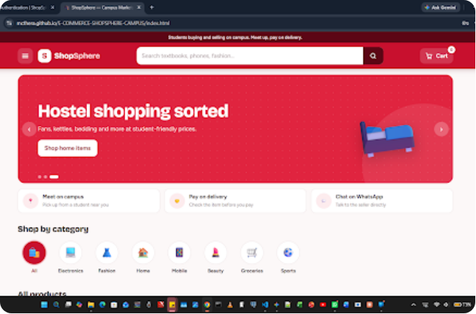
PLATFORM EXPERIENCE
Student Market Hub
An intuitive, vibrant landing page built specifically for student needs.
Hostel Shopping Banner
Direct promotions tailored for fans, kettles, bedding, and campus essentials.
Trust Features
Campus meetups, pay on delivery, and direct seller WhatsApp integration.
Category Navigation
Quick access to Electronics, Fashion, Home, Mobile, Beauty, Groceries, and Sports.

Slide 3

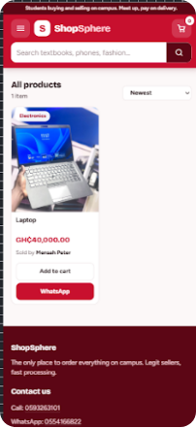
MARKETPLACE INTERFACE
Mobile-First Product Cards
Clear pricing, seller identity, and fast action triggers.
Transparent Pricing
Prominent currency displays (GHC) and category tags help students make quick purchasing decisions.
Seller Transparency
Listings display exact seller names (e.g., Mensah Peter) to build peer trust across halls.
Instant Communication
Direct 'WhatsApp' CTA button eliminates friction and allows real-time negotiation.

Slide 4
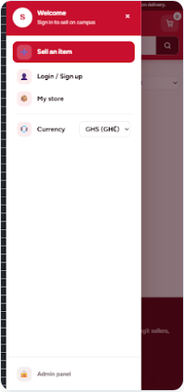
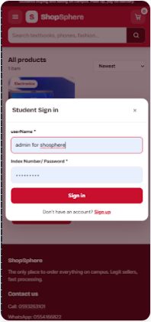
USER EXPERIENCE
Seamless Onboarding & Account Access
Student authentication tied directly to campus index credentials.
Campus Verified Login
Sign-in requires Index Numbers or student credentials to verify buyers and sellers.
Seller Quick Actions
Navigation drawer grants immediate access to "Sell an item" and "My store" management.
Role Management
Built-in portals for standard student accounts and administrative moderation.

Slide 5



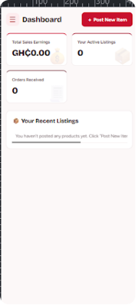

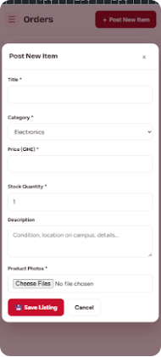
SELLER TOOLS
Dashboard & Inventory Posting
Empowering student entrepreneurs with lightweight store metrics.

Slide 6


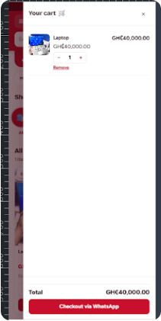
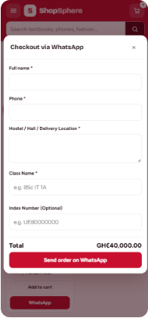
ORDER FULFILLMENT
WhatsApp Order & Campus Delivery
Frictionless checkout leveraging existing student communication channels.
1. Flexible Cart Management
Students adjust quantities and review total costs before committing.
2. Location Capture
Collects precise delivery locations (Hostel/Hall) and student details.
3. Instant Messaging Dispatch
Directly formats the order payload into a pre-filled WhatsApp message.

Slide 7



SUMMARY
Why ShopSphere Works
Built specifically to solve trust, payment, and delivery challenges in campus environments.
Zero Payment Friction
Hyper-Local Delivery
Micro-Merchant Growth
Pay-on-delivery via WhatsApp eliminates payment gateway setup and fees.
Direct hostel-to-hostel meetups ensure fast and secure item exchanges.
Empowers campus sellers with effortless store dashboards and item listing tools.

Slide 8
ShopSphere
Students buying and selling on campus. Meet up, pay on delivery.
Questions & Discussion

